Slide 1
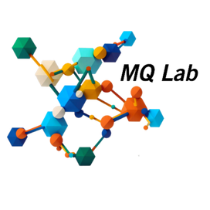

A Stratified NANI Approach for Fast and Scalable Clustering of Large MD Datasets
... and turning seeding into speed for hybrid clustering algorithms
Jherome Brylle Woody Santos
Miranda-Quintana Group | University of Florida
1

Slide 2
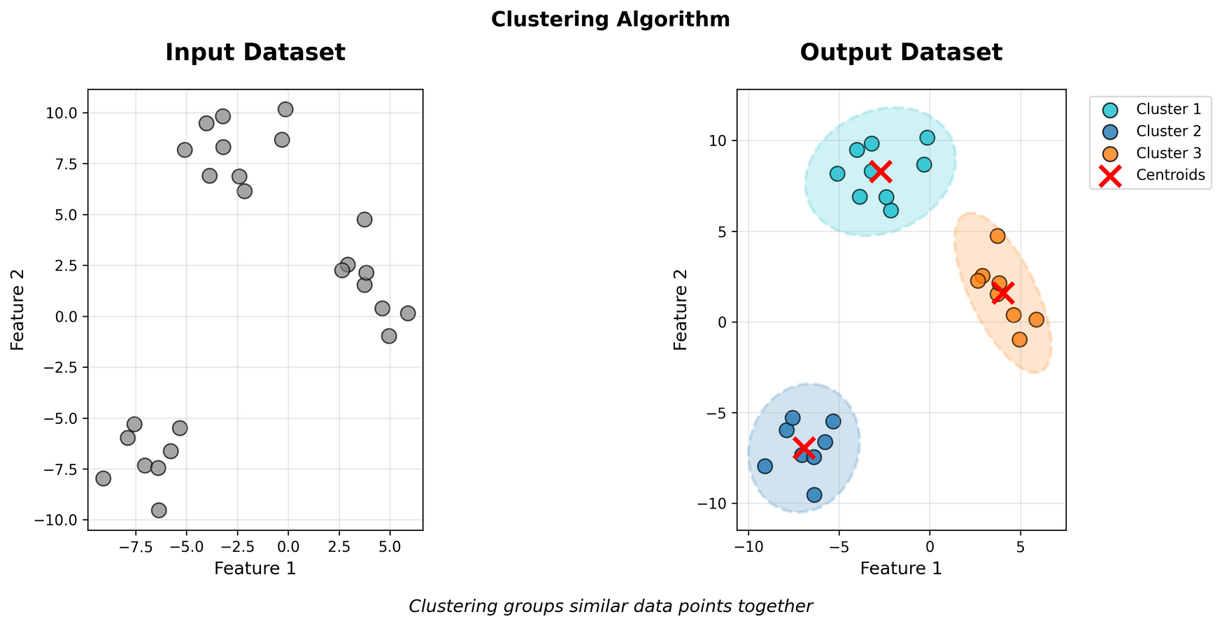
><
clustering
Goal: discover natural groupings in unlabeled data
How: define a representation, then group by intra-cluster cohesion and inter-cluster separation
Quality: clusters should be compact, well-separated, and stable across runs
2

Slide 3
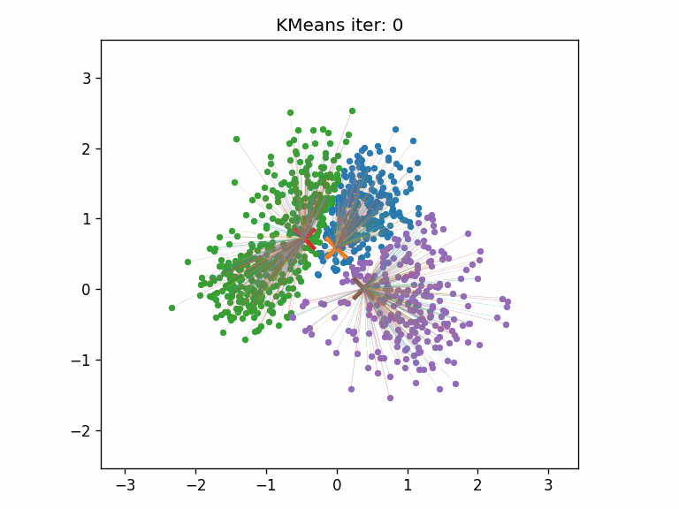
k-means
Goal: partition data into k clusters by minimizing within-cluster variance
Inputs: feature representation, k (number of clusters)
Iterate until stop:
Assign each point to its nearest centroid
Update each centroid to the mean of its assigned points
sensitive to initialization
3

Slide 4
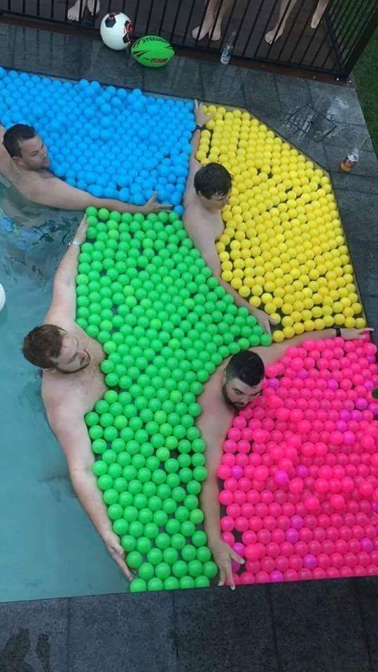
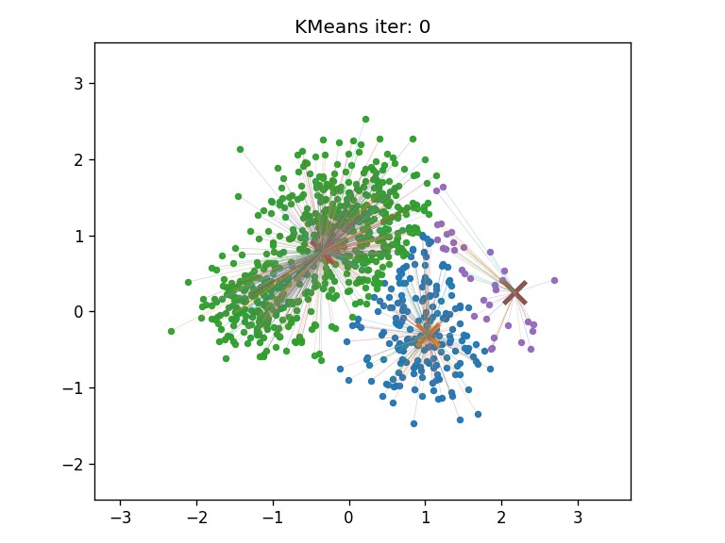
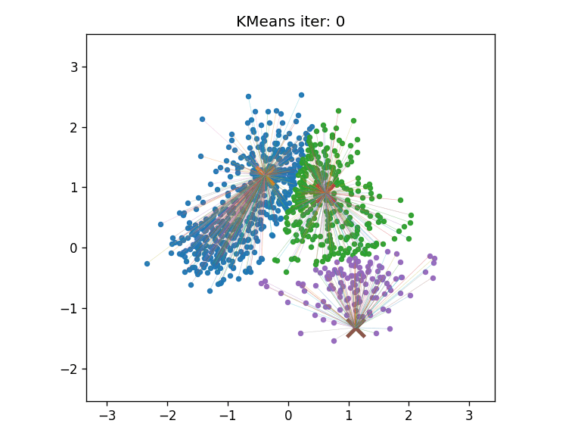
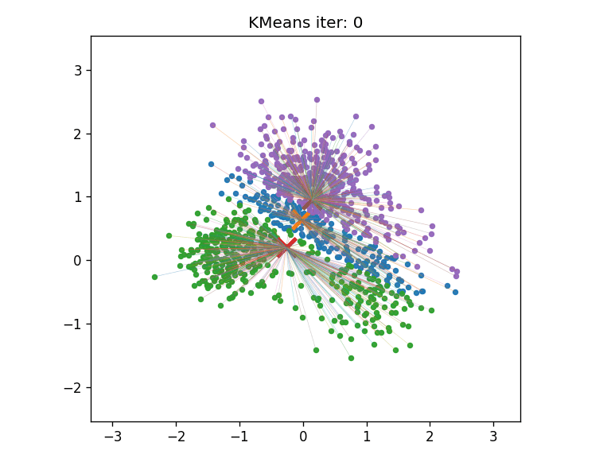
seeding
landscape
Random: quick, variable quality; needs many reruns
k-means++: better centers, still stochastic
NANI seeds: comp_sim (central→diverse) | diversity selection (global spread): deterministic, iterative
Random
k-means++
comp_sim
Reddit.com.https://www.reddit.com/r/Bossfight/comments/z2010d/the_ball_dividers_four_horsemen_of_the/ (accessed 2025-11-08).
4

Slide 5
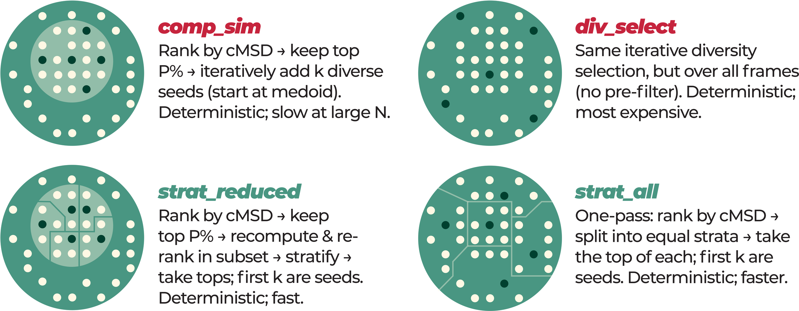
stratified
NANI
N-Ary Natural Initiation (NANI)
Single-pass, deterministic seeding (no reruns)
Stratified sampling across N-ary order → fast
Practical effect: seeding stops being the bottleneck
strat_all and strat_reduced
N-ary (set-wise) similarity - Compute one statistic over the whole set at one (not all pairs) | O(N)
cMSD (complementary MSD) - “Leave-one-out” importance of a frame: how much the set’s MSD changes if you remove it.
5

Slide 6








6

Slide 7

Similarity ↓ cMSD ↑
7

Slide 8

Similarity ↑ cMSD ↓
8

Slide 9
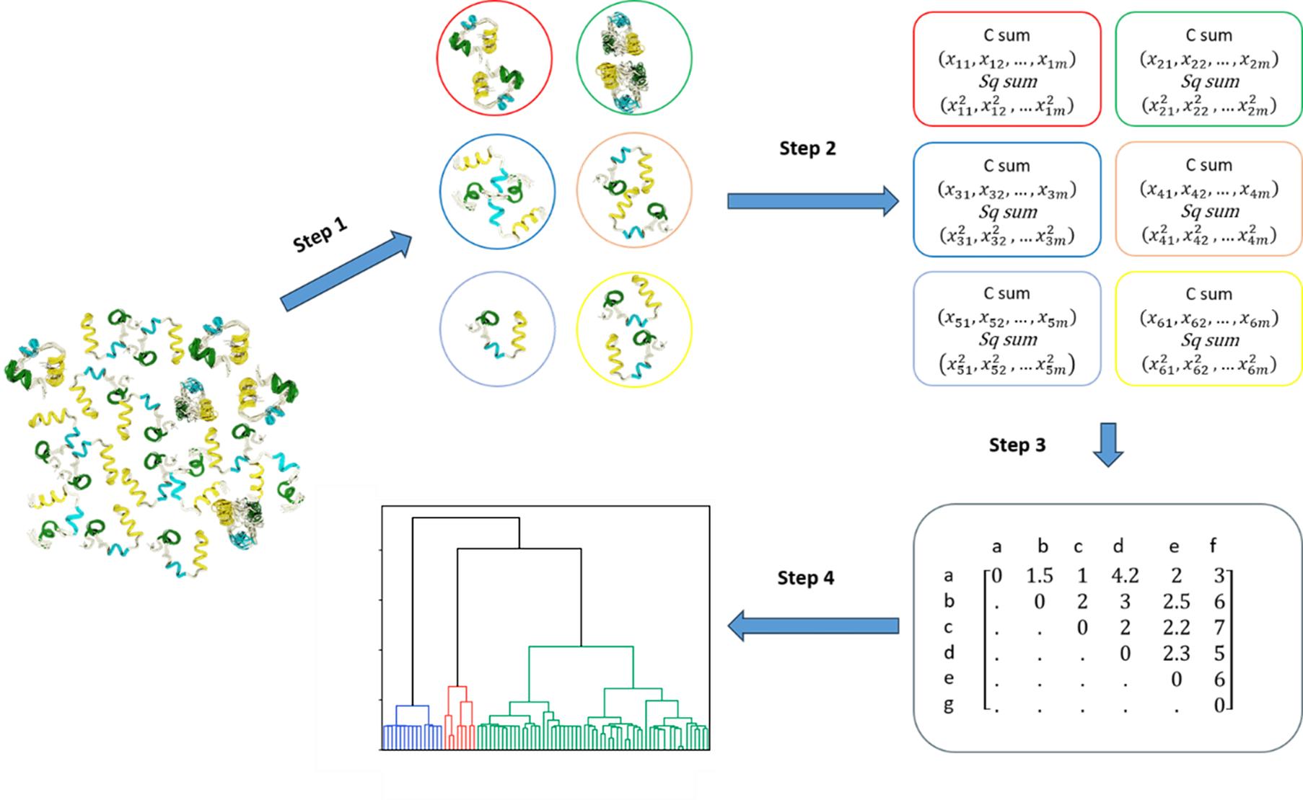
HELM
Hierarchical Extended Linkage Method
k-means microclusters → merges (HAC-style structure)
Uses N-ary linkage; no need for full pairwise distance matrix
k-means NANI provide deterministic microclusters
Use when you want hierarchy with k-means efficiency
9

Slide 10
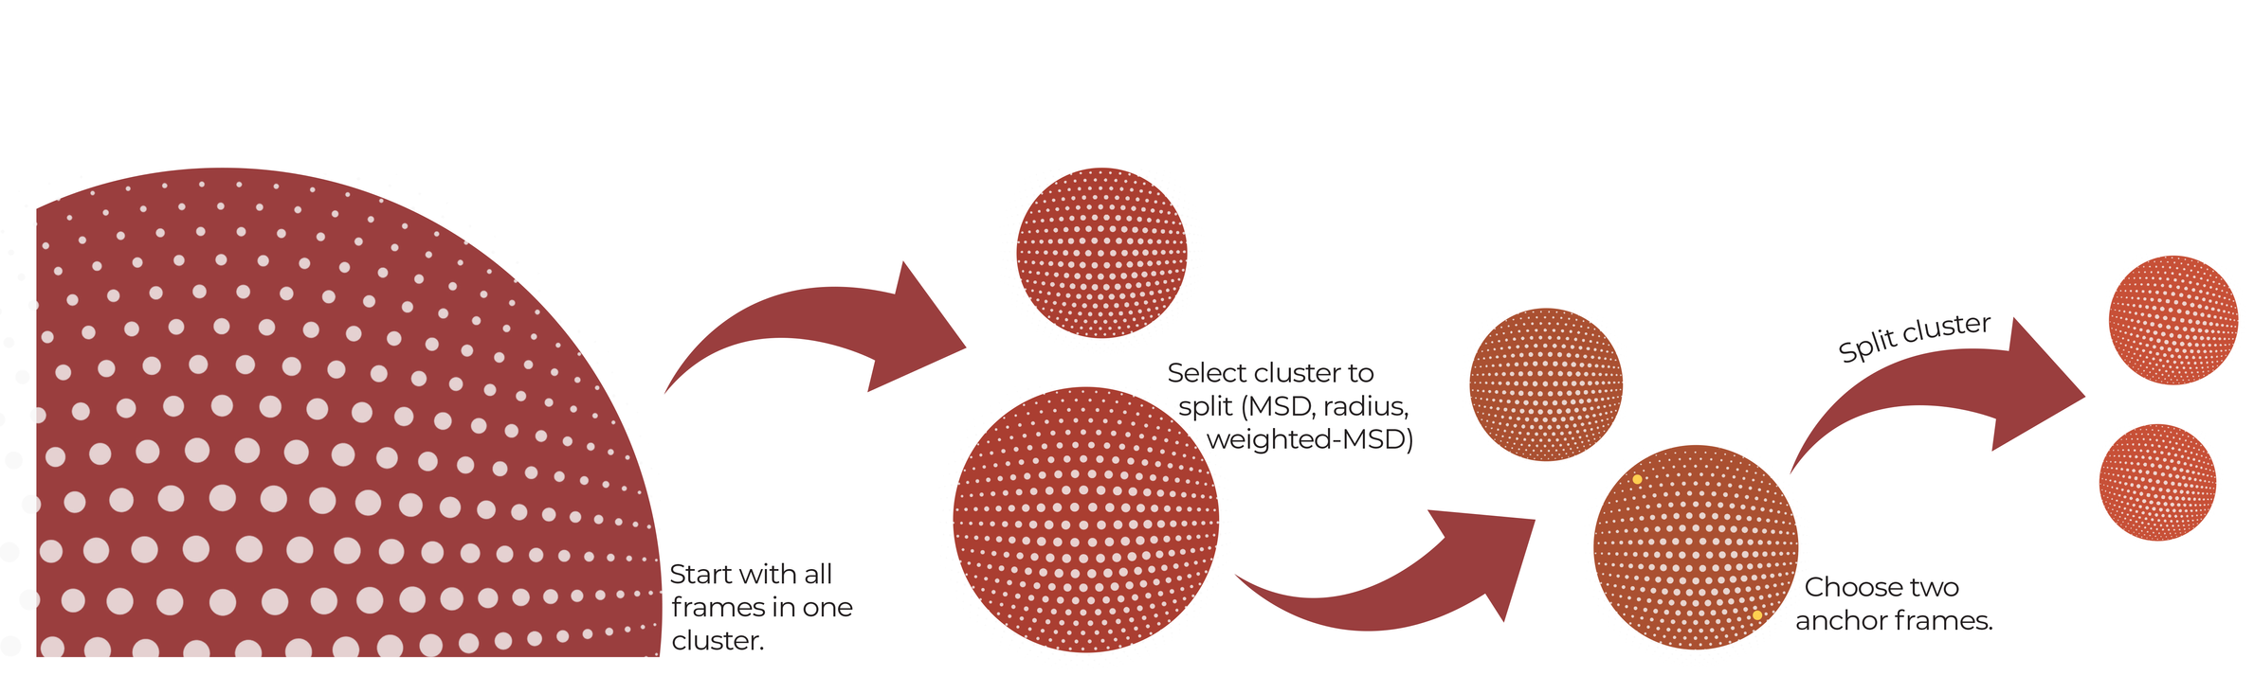
divine
DIVIsive N-ary Ensembles
One-pass divisive splits; retain the full tree
Deterministic anchors: NANI / outlier-pair / splinter split
Quick, reproducible top-down hierarchy
10

Slide 11
WHAT’S
NEXT
shine v.2
mdBIRCH
Sampling Hierarchical Intrinsic N-ary Ensembles
new release!!!
What: method that uses n-ary similarity measures and hierarchical clustering to deterministically cluster many molecular pathways
What: online clustering; near-linear behavior; no pairwise matrix
Control: single τ (threshold) → radius-bounded clusters
When to use: frames arrive continuously; complements batch tools
11

Slide 12

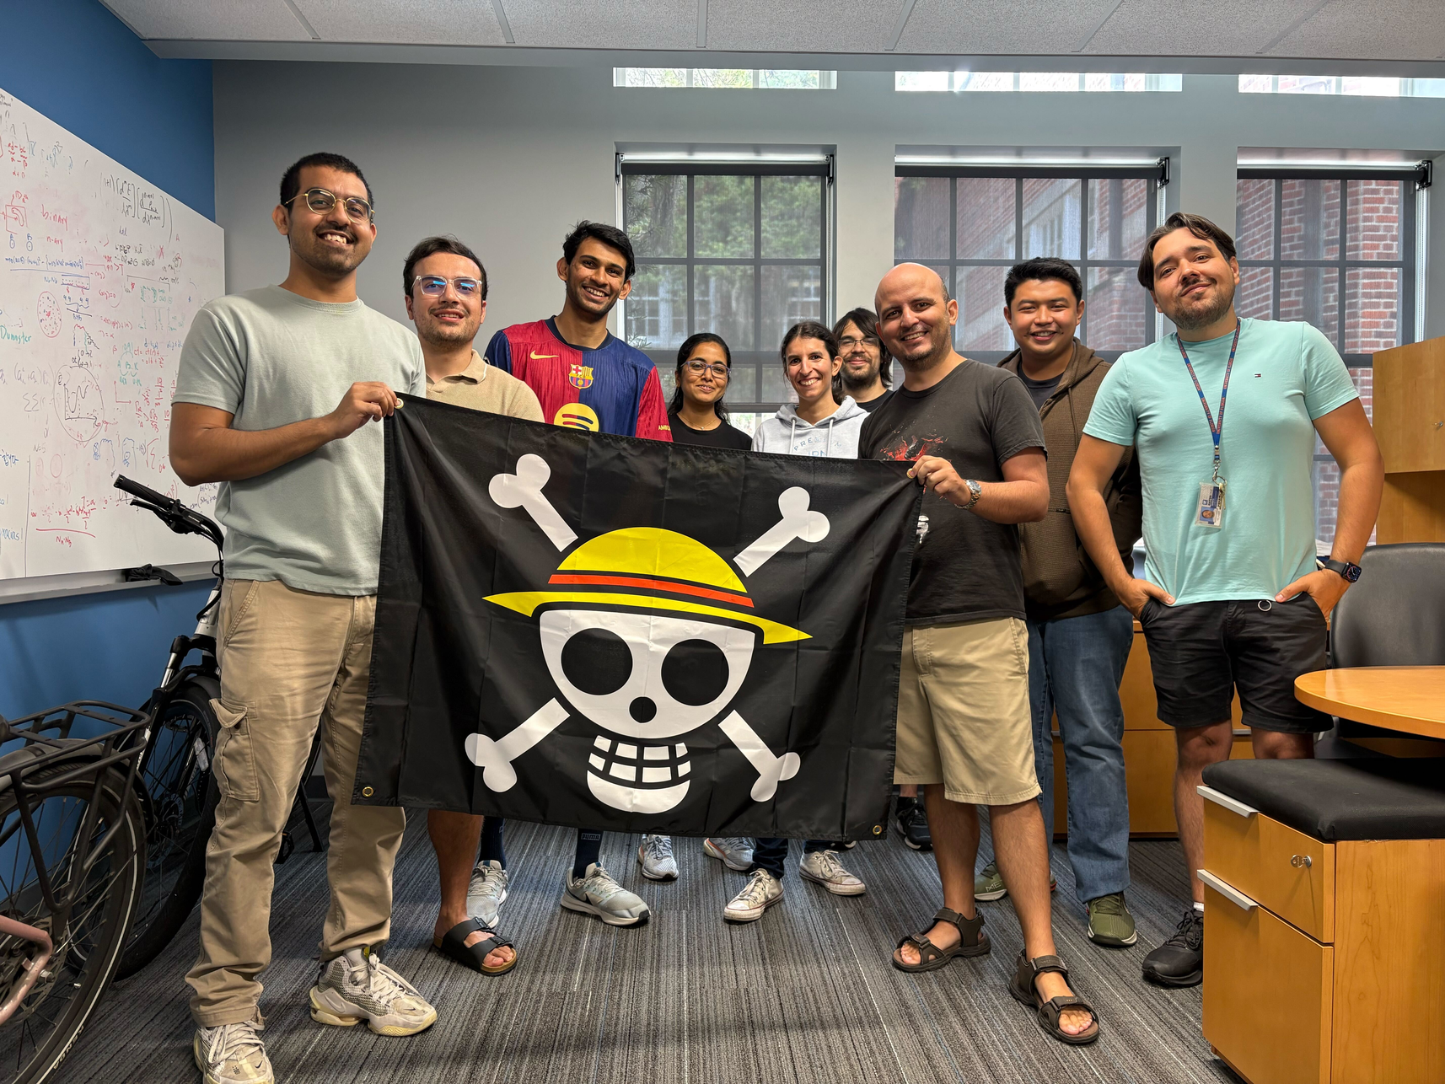



Acknowledgements
PI: Ramon Miranda-Quintana
Group Members:
Jherome Brylle Woody Santos
Lexin Chen
Kenneth Lopez Perez
Akash Surendran
Krisztina Zsigmond
Rugwed Lokhande
Ignacio Pickering
Pratiksha Gaikwad
12

